Slide 1

Welcome to the Waiting Well presentation by the Specialist ADHD Team

Slide 2
Waiting well
The following information will offer support and guidance on a range of behaviour interventions that may help you and your family while your child/young person is on our waiting list for an ADHD assessment.
Some of your children/young people may get this diagnosis some may not.
However the behaviours and concerns that have brought you to this point need to be supported regardless of whether you get this diagnosis or not.

Slide 3
We will cover
Signposting families to support available, both financial and school.
We will be looking at:
Age related behaviours.
Events that can affect your child’s behaviour.
How to handle difficult behaviour and how to encourage positive behaviour.
How to continue to strengthen your relationship with your child/young person.

Slide 4
Financial Support
Disability living allowance (DLA)
https://www.gov.uk/disability-living-allowance-children
Disability Living Allowance (DLA) for children may help with the extra costs of looking after a child who:
• Is under 16
• Has difficulties walking or needs much more looking after than a child of the same age who does not have a disability
They will need to meet all the eligibility requirements.
The DLA rate is between £23.60 and £151.40 a week and depends on the level of help the child needs.
Ref.gov.uk

Slide 5
Financial Support
The Family Fund
https://www.familyfund.org.uk
There mission is to provide items and services to all low-income families in the UK raising disabled or seriously ill children, that they could not otherwise afford or access, and that help improve their quality of life, realise their rights, and remove some of the barriers they face.
They provide grants for a wide range of items, such as washing machines, sensory toys, family breaks, bedding, tablets, furniture, outdoor play equipment, clothing and computers. It can be a struggle financially, emotionally and physically for families raising a disabled or seriously ill child, and these grants help break down many of the barriers families face, improving their quality of life and easing the additional daily pressures.
ref. Family fund.org

Slide 6
Derbyshire SEND support
https://www.derbyshireiass.co.uk/home.aspx
Derbyshire Information, Advice and Support Service (DIASS) provides independent information, advice and support to children and young people with special educational needs and disabilities (SEND), as well as their parents and carers.
We aim to help parents and carers increase their involvement in the education of their children and ensure that they have access to information and advice about issues relating to a child or young person's health and social care.
The service is impartial, confidential, and works at arm's length from the local authority. The advice is free and accessible to all parents of children with SEND.

Slide 7
Derby City SEND Support
https://derbysendiass.org.uk
Are you finding it hard to get your voice heard?
Do you need someone impartial and confidential to talk to about the
support your child or young person receives?
Do you need information about education, health or social care
systems in relation to Special Educational Needs and Disability (SEND) provision?
Do you need support in discussions with your child’s school or Local
Authority?
Has your child or young person been excluded or at risk of exclusion
from school or on a part time timetable?
Derby City SEND Support offers Free, confidential, impartial information, advice and support for parents, children and young people up to the age of 25 about Special Educational Needs and Disabilities.

Slide 8
Local offer
A local offer gives children/young people and their families information about what support services are in your local area.
Further support and information can be found on the local offer websites.
Derbyshire residents:
https://localoffer.derbyshire.gov.uk/#!/directory
Derby City residents:
https://www.derby.gov.uk

Slide 9
Graduated response for individual pupils (GRIP)
Derbyshire's GRIP initiative is for pupils with significant special educational needs in primary and secondary schools.
If an application is successful, schools will receive GRIP funding straight away.
The GRIP funding will give schools and parents and carers the opportunity to be more flexible in how pupil support is best delivered and a range of interventions can be considered. Parents and carers must be fully involved and agree the GRIP plan in partnership with schools.
Accessed via the Local Offer (search GRIP funding)

Slide 10

Developmental behaviours
All children develop at different rates
Some children learn skills faster than others.
The following is a guide only.

Slide 11
Expected Developmental Behaviours
5-7 years
Seeks adult approval
Craves attention
Easily embarrassed
Can get very upset easily
Heightened anxiety and fear of new environments
Finds it difficult to share
Afraid of failure
Start having tantrums again
Can test limits
Finds it hard to express emotions gets frustrated or angry
Can feel misunderstood.

Slide 12
Expected Developmental Behaviours
8-11years
Dislikes change
Appears not to be listening
May be unaware of other peoples feelings/Opinions
Things may be black/white right or wrong
Push against rules can be disrespectful
Can be selfish
Argumentative
Moody
Withdrawn
Pushes boundaries
Wanting more independence.

Slide 13
Adolescents
Going through huge brain development changes
Friends more important then family
Can get stressed on what their peers think of them
Can make silly decisions or take part in risky behaviours
Can be emotionally detached from you
They will act like your opinion of them does not matter but it does more than ever
More argumentative
Wanting more independence
Will experiment with their image and identity
Feel under pressure from both school and home
Can be sexually active
Sleep cycle will change

Slide 14
Children and young people may sometimes
Lie, steal, have temper tantrums, shout, hit and swear. These are all ways of getting your attention and asking for help.
When you acknowledge that this behaviour is a plea for help you can react in a more constructive way.
Punishing this behaviour will not help your relationship, although children do need to know what is acceptable and what is not. This is where boundaries and rules come in.

Slide 15
Things that can affect your child’s Behaviour
It is important to remember the ``Negative’’ behaviour is often a plea for help.
Any changes in a child’s life can be difficult for them, such as separation of family, bereavement, changing schools and even a fall out with a friend or losing their special toy.
All can be triggers for negative behaviours as children and young people don’t always have the emotional words and understanding to express themselves.
It is important to be open about your own emotions, make talking about emotions and feelings part of normal family life. Remember to discuss positive emotions too!!
It is ok to feel worried or anxious about going somewhere new, it’s about teaching them how to cope in this situation. Sharing ideas to make it work.
After the event talk about how well it went and how they felt afterwards.

Slide 16
Routines and Boundaries
Having inconsistent routines and boundaries is very confusing for children and young people.
Schools use rules and boundaries to help children feel secure and this is the same at home.
Being clear and consistent with what is acceptable.
Have rules visible and easy to refer to.
Do not get into arguments and power battles, this will only damage the relationship.

Slide 17
Building your relationship with your child/young person
The following is all suggestions that with help to continue to Build your relationship with your child/young person
Have quality time with your child
Be interested in their interests
Encourage them to express their emotions/feelings
Respect and acknowledge their feelings
Have rules, boundaries, rewards, consequences and structure in place

Slide 18
Family meeting
Family meetings are good for:
Practice communication
Gives them a chance to express their opinion
Overcome challenges together
Reflect on feelings
Discuss family values/Rules
Set and share goals
Have fun and inspire one another
Appreciate each other
Feel valued
Come back and address in a few weeks time and make adjustments if needed
Children/Young people need guidance to give them security and allows them to feel safe.

Slide 19
How and what to include
Keep it relaxed and fun.
Rules of the house to be agreed by all, remember to compromise, make them positive and not have too many, 3 is a good amount.
Make them visual and have them on display, so you can refer to them easily.
Discuss
Any new Routine/ Boundaries
Rewards/incentives
Consequences
Children/Young people need guidance to give them security and allows them to feel safe.

Slide 20
Routines
Routines will help to give your child’s life some structure and a sense of security.
Can help children understand time and time management.
Can establish important habits such as self care and independence.
Can strengthen relationships by having time together.
Use Visual aids this will help your children remember what is expected.

Slide 21

Reward the positive behaviours
Some ideas to try
Descriptive praise
Activity of their choice e.g.
Read a book
Watch a DVD
Trip to the park
Have a sleep over/friend round
Small toy
Go for a bike ride.
Go Swimming
Choose what's going to be for tea/pudding

Slide 22

Reward the positives
Quality time with you
Positive comments
Car time - them having the car/you taking them
Special meal- Pizza or them being allowed to cook
Extended curfew
Extended computer /social media time
A hug

Slide 23
Ideas for consequences
Loss of privilege
Reduced media time
No special toiletries
Reduced pocket money
Home early
Have to do a chore around the house
Don’t threaten something you can’t follow up.
Time out reflection time.
Less time gaming/screen time.
No Playing with friends.
To ignore some negative behaviours.
Talking to them.

Slide 24
Anger
If your child is angry, its important to find out what the underlining problem is as it could be a build up of small issues that have mounted up.
Suggestions on how to manage
It is important that if a child is angry for then to express that emotion in a controlled way.
To do this you could provide the following:
Bean bag/pillow to hit out at
Punch bag
Trampoline to release the energy
Thera putty/playdough
Calm down space- Tent with calming activities etc

Slide 25
Outbursts/meltdowns
What to do if they have lost it!
It is important that your child knows that it is the behaviour you do not like, not them!
See the behaviour separate to the child.
Keep calm, ignore if safe to do so.
Do not discuss incident, if your child is in the throws of an outburst, they are not listening!
Give your child time to calm down!(Safe space)
Discuss later if the child approaches you and wants to discuss.
If your child wants to talk about it .. Keep it positive, don’t re-ignite the outburst.

Slide 26
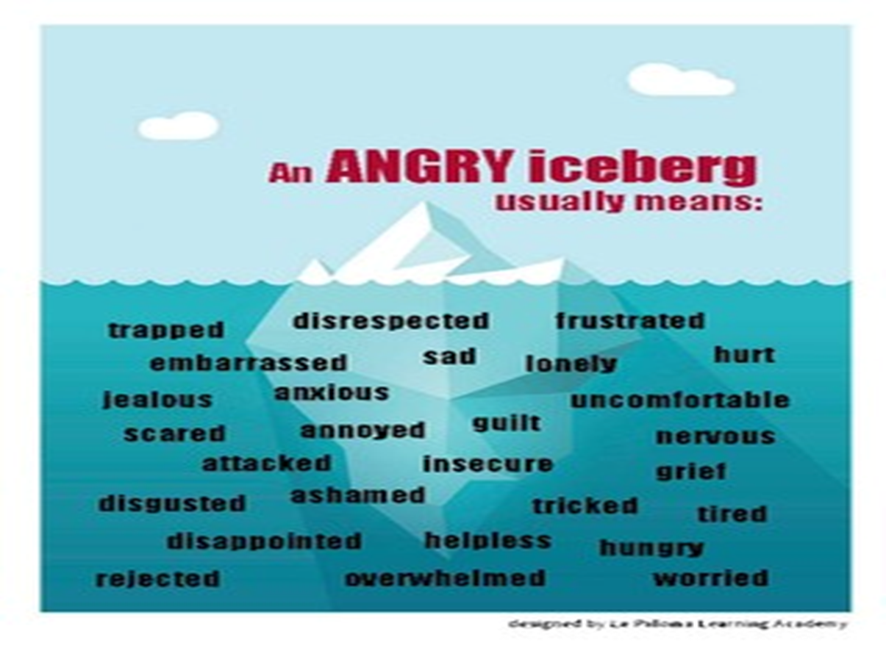
Underneath the anger are all these feelings

Slide 27
Encouraging positive behaviour
Descriptive praise and encouragement are powerful motivators. Avoid criticism and nagging.
Use rewards and other incentives to re-enforce the positive.
Notice and comment positive interaction and play with siblings and others.
Praise your child in front of others (great for self esteem).
Be a positive role model- Children often act out what they see, you smile /they smile.
Apologise if your in the wrong.
Take time to develop your relationship with your child, teach them how to resolve difficulties with alternatives.

Slide 28




Mindfulness apps
The apps are designed to support young people with managing stress and anxiety The age suitability for each app has been advised by the developers.
The following apps are listed on the NHS website:
Silver cloud 16+
Chill Panda Children and Adults
Relax melodies children and Adults.
Smiling Minds 7-18yrs

Slide 29
Sleep
Lack of sleep can impact behaviour in a negative way:
Poor memory and attention
Anxiety, irritability, hyperactivity
Behaviour deteriorating, with aggression and tantrums
Impact on growth
Knock-on effect on the sleep of other family members leading to stress and tiredness

Slide 30
How to improve sleep
Discuss with your child their thoughts and ideas for new routine
Write down simple routine with visual cues
Whole family approach
Be Consistent
Rewards in place for small steps and improvements
Gentle exercise late afternoon
Sleepy foods – Healthy snack or drink.
Wind-down time 1 hour before bedtime: reading, colouring books or relaxing music. Use a timer
Bath, not shower, and brush teeth.
Once routine has started do not back track
Bedtime story/chat

Slide 31
Anxiety
We all can get nervous from time to time leading to anxiety when we have an appointment to attend e.g.: an interview, going to the Dentist or Doctors etc.
Sharing your emotions with your child/young person is important as it can help to normalise feelings.
Children/young people can have difficulty expressing or dealing with their emotions.
The following slides are a guide on how you can help.

Slide 32
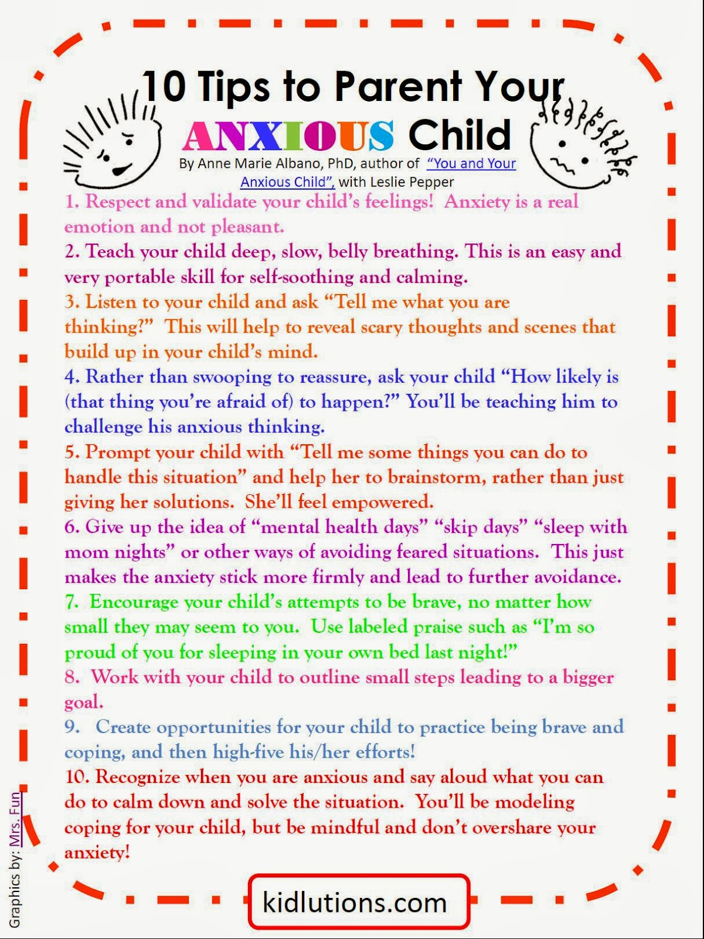

Slide 33
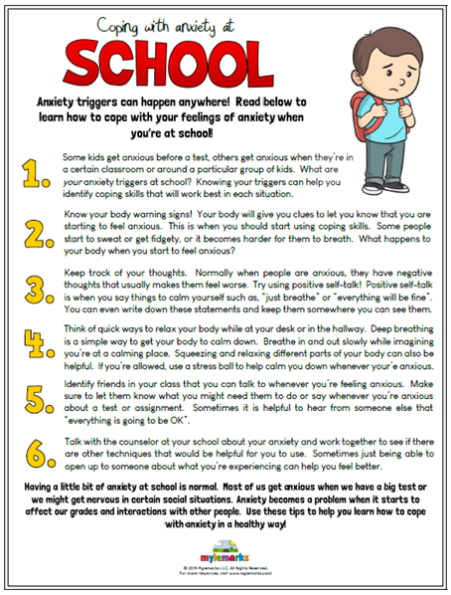

Slide 34
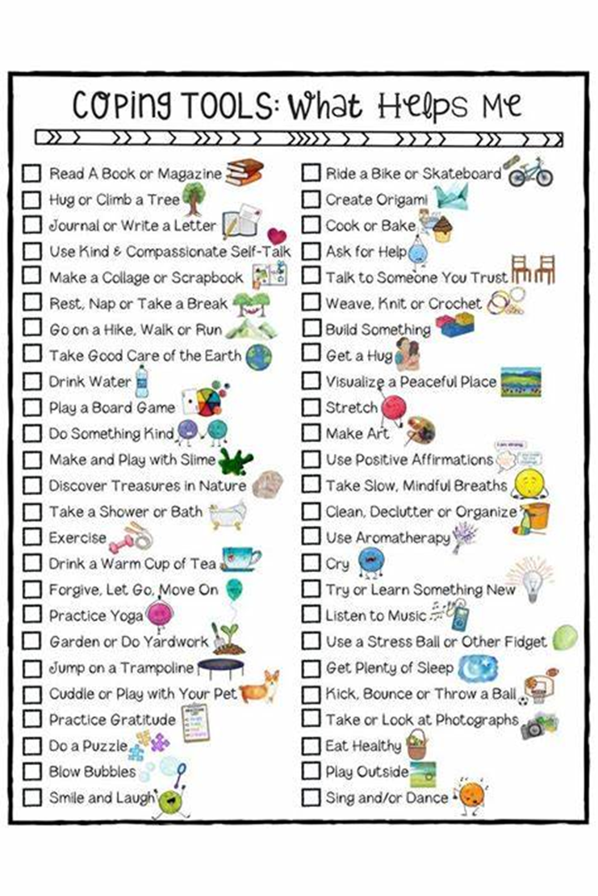

Slide 35
Tics
There are many types of tic. Some affect body movement (motor tics) and others result in a sound (vocal or phonic tics).
Examples of tics include:
Blinking, wrinkling the nose or grimacing
Jerking or banging the head
Clicking the fingers
Touching other people or things
Coughing, grunting or sniffing
Repeating a sound or phrase – in a small number of cases, this may be something obscene or offensive
Tics can happen randomly and they may be associated with something such as stress, anxiety, tiredness, excitement or happiness. They tend to get worse if they're talked about or focused on.
They often start with an unpleasant sensation that builds up in the body until relieved by the tic – known as an urge – although they can sometimes be partly suppressed.
Read more about common types of tics.

Slide 36
When to see a GP
Tics are not usually serious and they do not damage the brain.
You do not always need to see a GP if they're mild and not causing problems. Sometimes they can disappear as quickly as they appear.
See a GP if you're concerned about your or your child's tics, you need support or advice, or the tics:
occur very regularly, or become more frequent or severe
cause emotional or social problems, such as embarrassment, bullying or social isolation
cause pain or discomfort (some tics can cause the person to accidentally hurt themselves)
interfere with daily activities, school or work
are accompanied by anger, depression or self-harm
A GP A GP will follow the TIC pathway and make a referral to a paediatrician

Slide 37
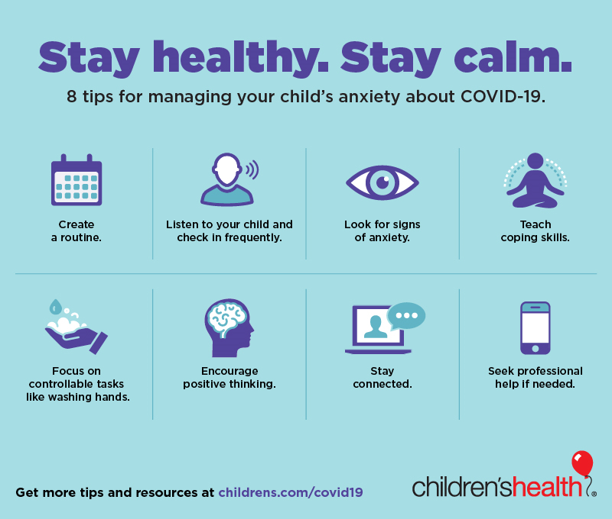

Slide 38

And Finally
Communication is key.
Be consistent with your rules and boundaries
Stay positive
Lead by example- Apologise if your in the wrong
Reflect on what went well and why
If you have a difficult day, stay strong and start afresh the next day

